Slide 1
ArchiMate®
An Introduction

Slide 2









Governance
Notes:
establish POLICIES and share best PRACTICES
CONSENSUS and INTEGRATION between methodologies

Slide 3
ArchiMate communicates actions carried out by particular things using specific stuff

Slide 4
Components
Language
Notation
Deliverables
Notes:
establish POLICIES and share best PRACTICES
CONSENSUS and INTEGRATION between methodologies

Slide 5
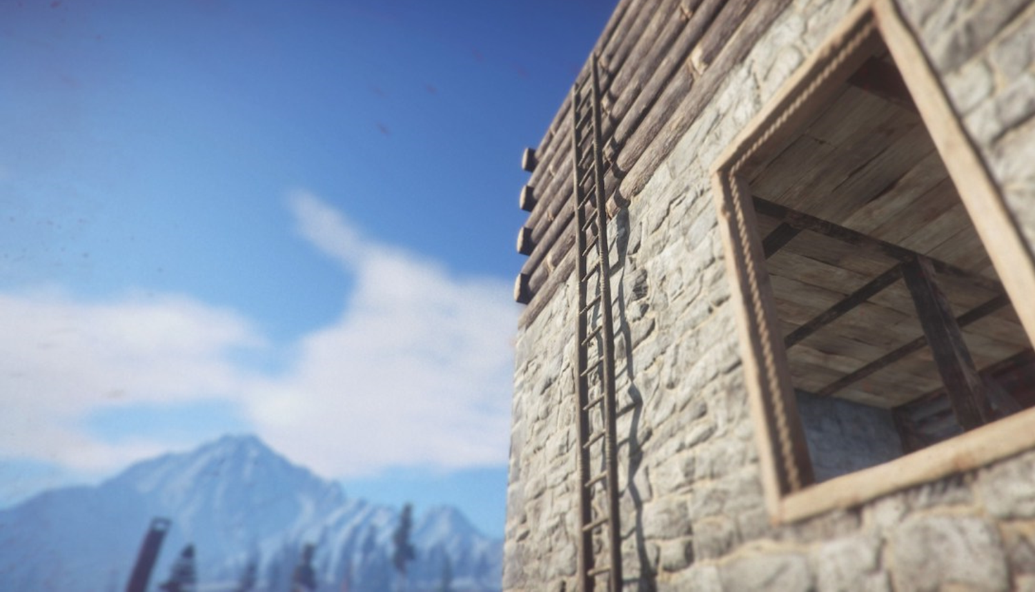
CONJECTURE
PREDICTION
CONNECTION
ENOUGHNESS
Argyris’ “Ladder of Inference”
Notes:
Describe the PUZZLE for BIG picture and its PIECES for DETAILED
Not about “BIG PICTURE” – but “ENOUGH PICTURE”

Slide 6




“UML describes the buildings, Archimate describes the cities”
Describes “human” sequence flows and orchestrations
Notes:
Archimate isn’t a UNIFIED model
PERSONAL PREFERENCE how to DRILL DOWN
RELATE to the whole
PURSUE the details

Slide 7


Mapping influence
Provoking realistic scenarios
Communicating gaps
Modelling
Driving lines of enquiry
Documenting requirements
Notes:
COMMUNICATION TOOL
RECORD OBSERVATIONS – how things ARE
BRING YOUR OWN EXPERIENCE AND UNDERSTANDING
GIVE IMPRESSIONS

Slide 8

Intended user base
Structure
Interoperability
Platform requirements
Notes:
CLEARLY
CONCISELY
CONSISTENTLY

Slide 9
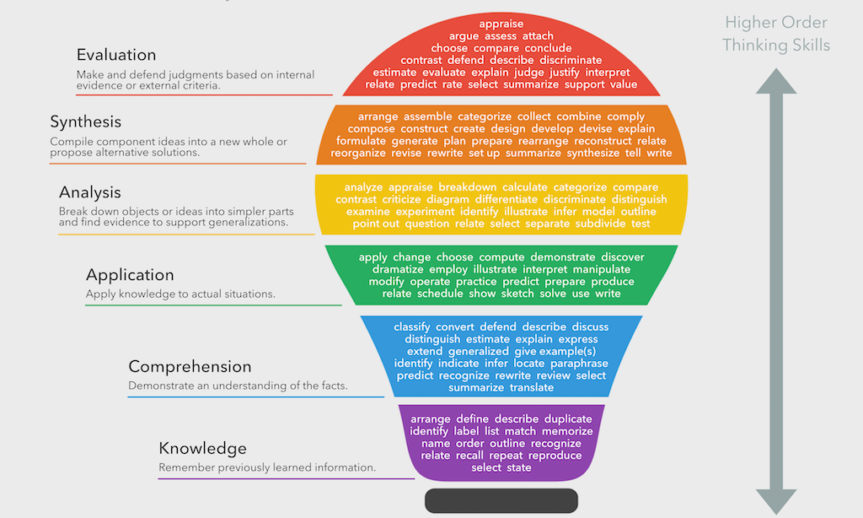
http://www.bloomstaxonomy.org/
Notes:
(Bloom – Learning Taxonomy)
CRITICAL THINKING tool
CONTEMPLATION
FLEXIBLE TOOLS to play WHAT IF

Slide 10
Who are you? What’s your role in solution design? Which of your colleagues could tell a good design from a bad design?

